Slide 1
Decision Trees

Slide 2
Types of Decision Tree
-CART (Regression Trees)
Twoing Algorithm
Gini Algorithm
-ID3
-C4.5 – C5.0

Slide 3
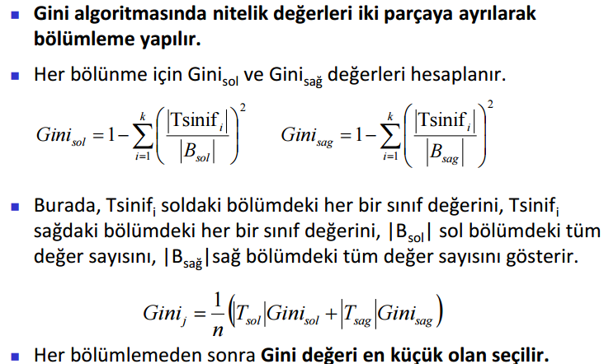
Gini Algorithm

Slide 4
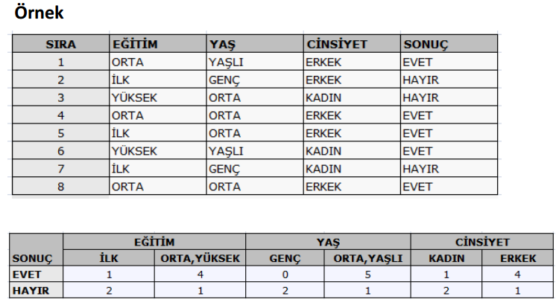
Gini Algorithm

Slide 5
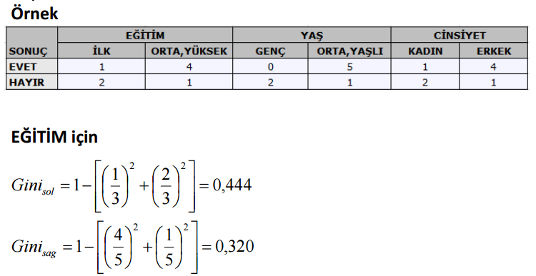
Gini Algorithm

Slide 6
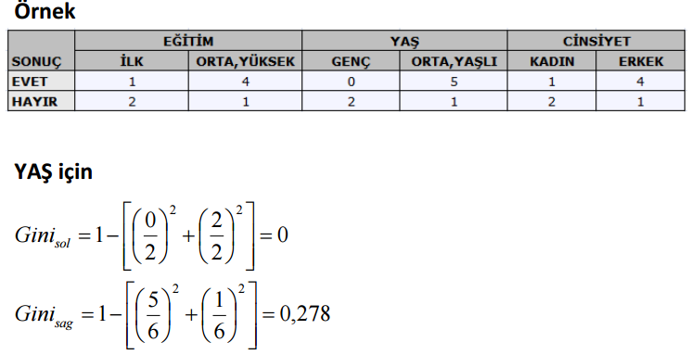
Gini Algorithm

Slide 7
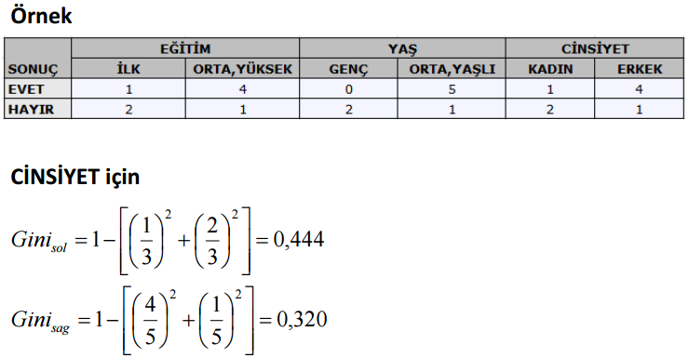
Gini Algorithm

Slide 8
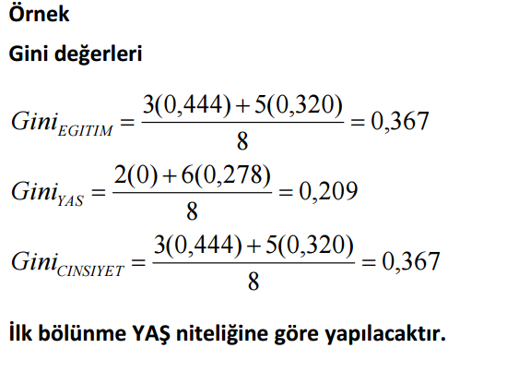
Gini Algorithm

Slide 9
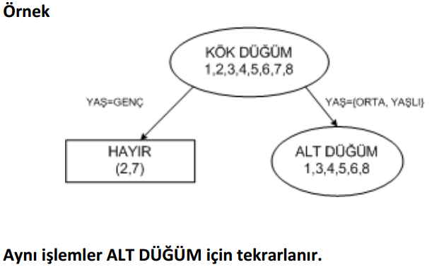
Gini Algorithm

Slide 10
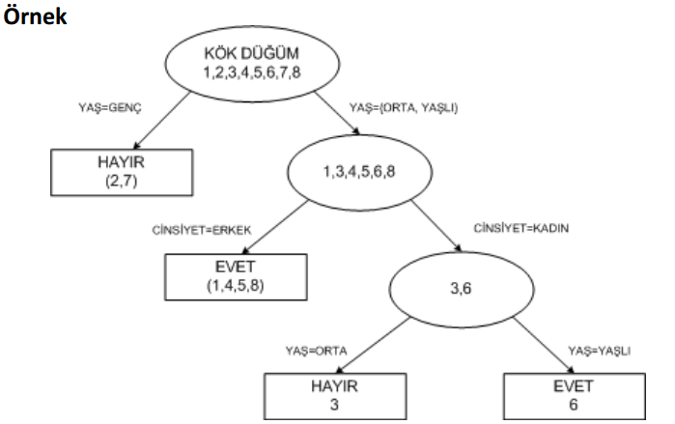
Gini Algorithm

Slide 11
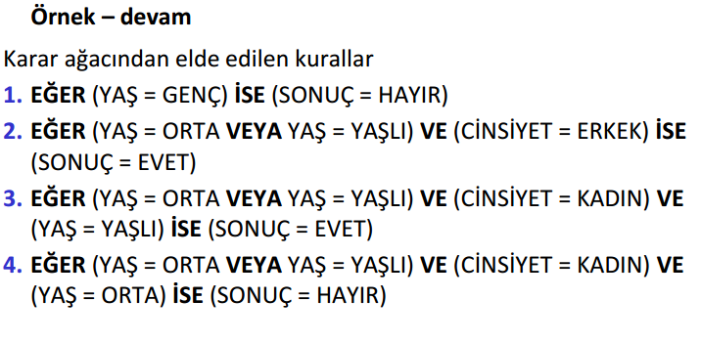
Gini Algorithm

Slide 12
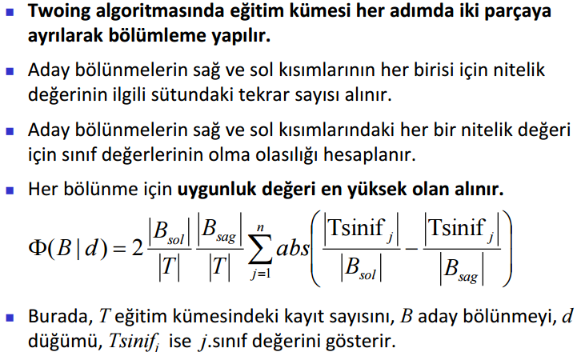
Twoing Algortihm

Slide 13
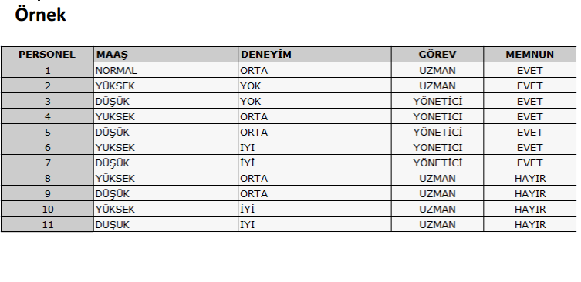
Twoing Algortihm

Slide 14
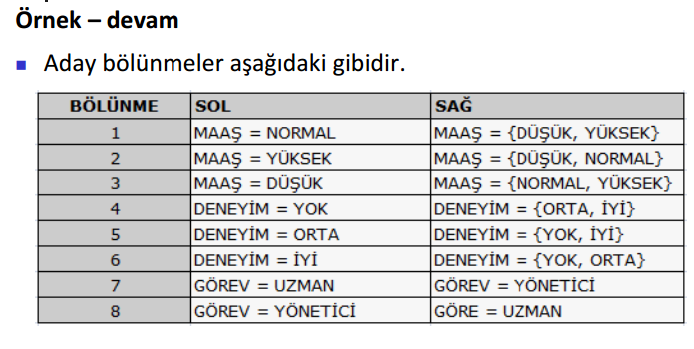
Twoing Algortihm

Slide 15
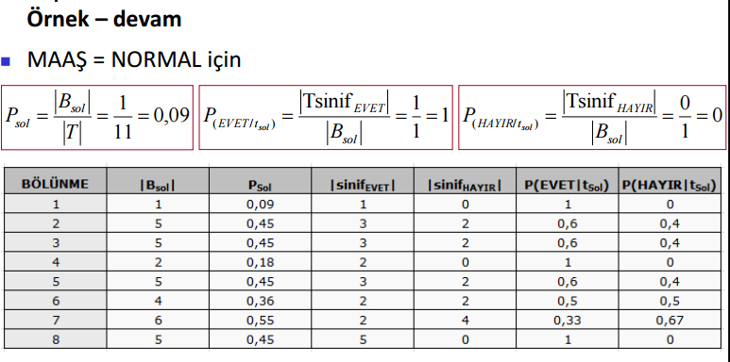
Twoing Algortihm

Slide 16
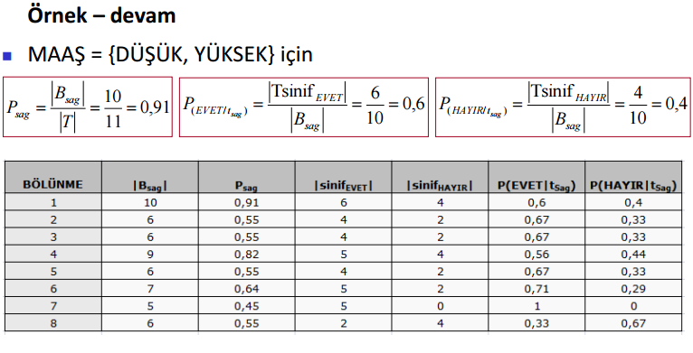
Twoing Algortihm

Slide 17
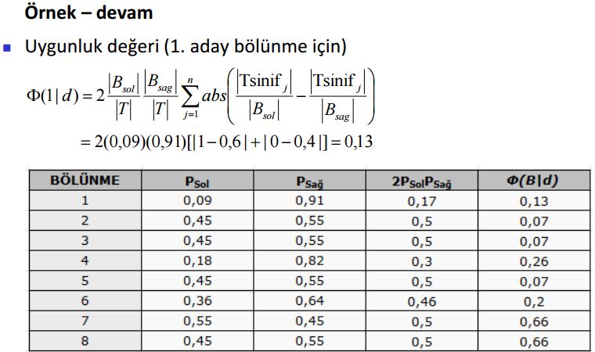
Twoing Algortihm

Slide 18
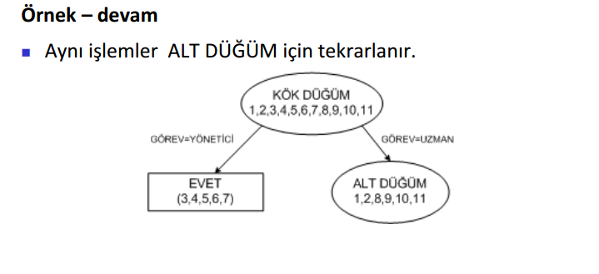
Twoing Algortihm

Slide 19
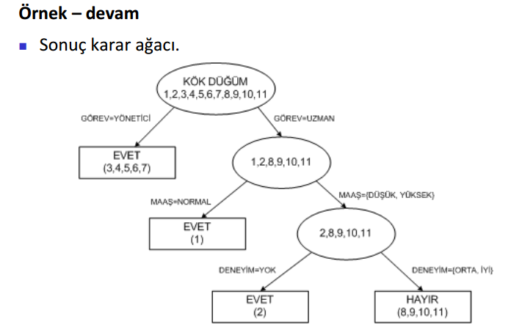
Twoing Algortihm

Slide 20
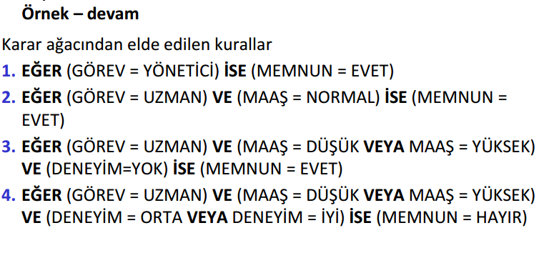
Twoing Algortihm

